Slide 1

Chapter 13
Digital Signature
Copyright © The McGraw-Hill Companies, Inc. Permission required for reproduction or display.
13.<number>

Slide 2
13.1.1 Inclusion
A conventional signature is included in the document; it is part of the document. But when we sign a document digitally, we send the signature as a separate document.
13.<number>

Slide 3
13.1.2 Verification Method
For a conventional signature, when the recipient receives a document, she compares the signature on the document with the signature on file. For a digital signature, the recipient receives the message and the signature. The recipient needs to apply a verification technique to the combination of the message and the signature to verify the authenticity.
13.<number>

Slide 4
13-2 PROCESS
Figure 13.1 shows the digital signature process. The sender uses a signing algorithm to sign the message. The message and the signature are sent to the receiver. The receiver receives the message and the signature and applies the verifying algorithm to the combination. If the result is true, the message is accepted; otherwise, it is rejected.
Topics discussed in this section:
13.2.1 Need for Keys
13.2.2 Signing the Digest
13.<number>

Slide 5
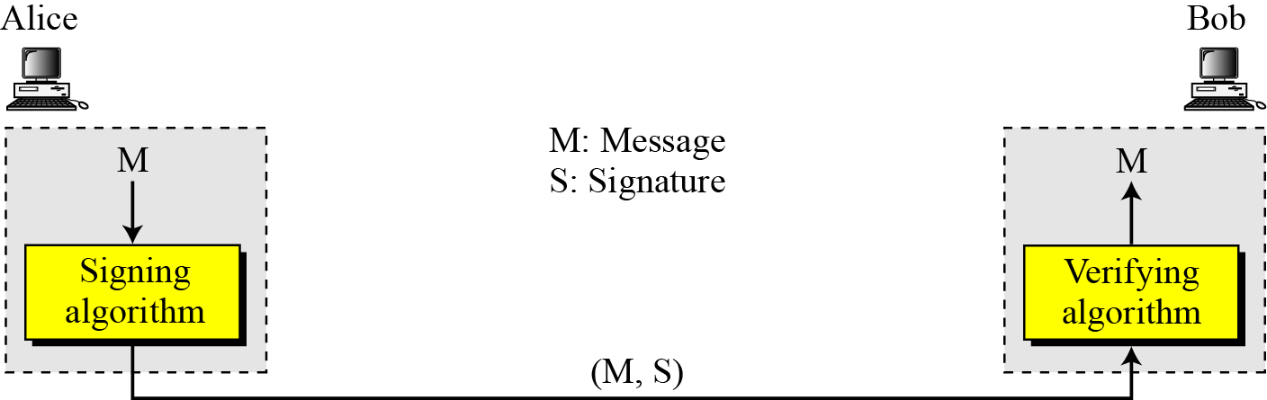
13-2 Continued
Figure 13.1 Digital signature process
13.<number>

Slide 6
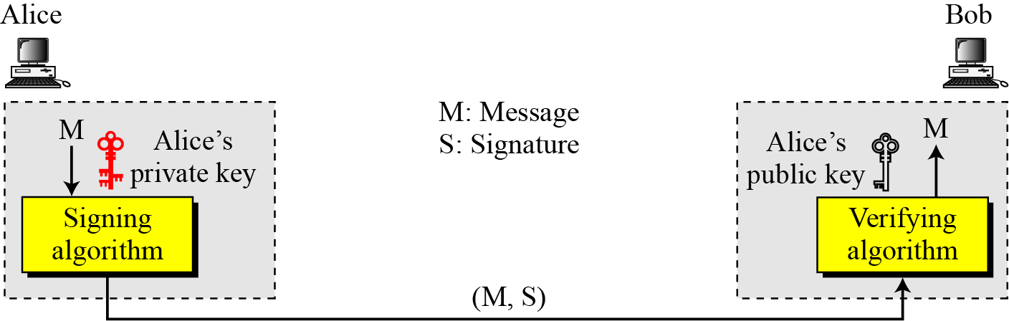

13.2.1 Need for Keys
Figure 13.2 Adding key to the digital signature process
Note
A digital signature needs a public-key system.
The signer signs with her private key; the verifier verifies with the signer’s public key.
13.<number>

Slide 7
13.2.1 Continued
Note
A cryptosystem uses the private and public keys of the receiver: a digital signature uses
the private and public keys of the sender.
13.<number>

Slide 8
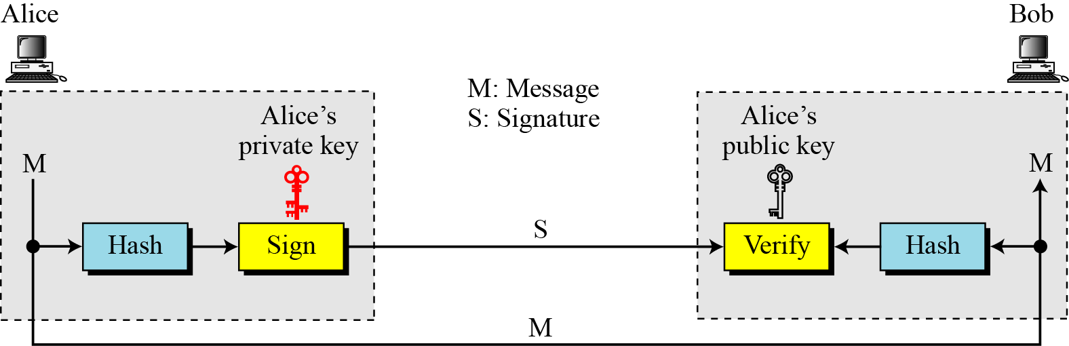
13.2.2 Signing the Digest
Figure 13.3 Signing the digest
13.<number>

Slide 9
13-3 SERVICES
We discussed several security services in Chapter 1 including message confidentiality, message authentication, message integrity, and nonrepudiation. A digital signature can directly provide the last three; for message confidentiality we still need encryption/decryption.
Topics discussed in this section:
13.3.1 Message Authentication
13.3.2 Message Integrity
13.3.3 Nonrepudiation
13.3.4 Confidentiality
13.<number>

Slide 10
13.3.1 Message Authentication
A secure digital signature scheme, like a secure conventional signature can provide message authentication.
Note
A digital signature provides message authentication.
13.<number>

Slide 11
13.3.2 Message Integrity
The integrity of the message is preserved even if we sign the whole message because we cannot get the same signature if the message is changed.
Note
A digital signature provides message integrity.
13.<number>

Slide 12
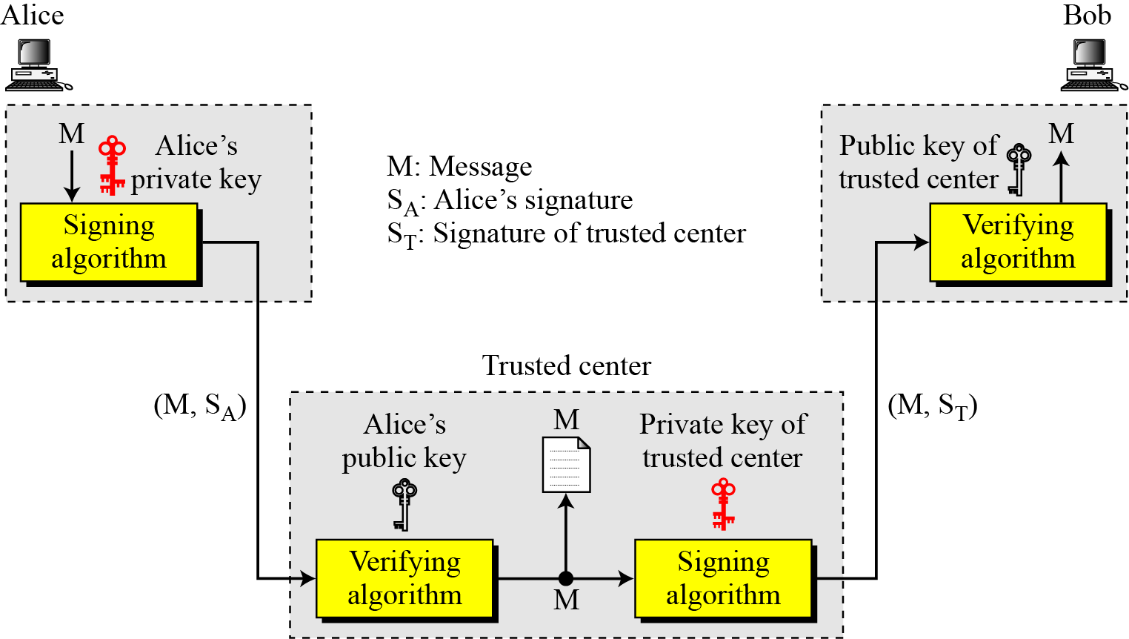
13.3.3 Nonrepudiation
Figure 13.4 Using a trusted center for nonrepudiation
Note
Nonrepudiation can be provided using a trusted party.
13.<number>

Slide 13
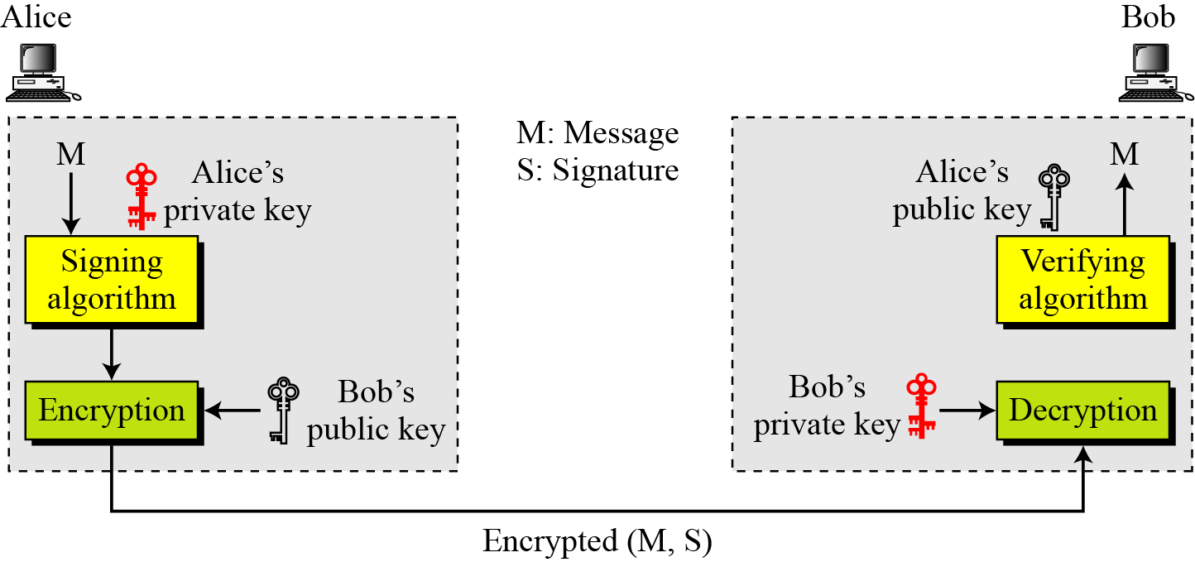
13.3.4 Confidentiality
Figure 13.5 Adding confidentiality to a digital signature scheme
Note
A digital signature does not provide privacy.
If there is a need for privacy, another layer of encryption/decryption must be applied.
13.<number>

Slide 14
Public Key Infrastructure
Meeting legal Requirement
-Privacy: Only intended recipient can read the files
-Integrity: Guarantees files are unaltered during
transmission
-Authentication: Ensures that parties involved are
who they claim to be
-Non-repudation: Prevents individuals from denying
involvement in a transaction.

Slide 15

Digital Signature Process Illustrated
The Hash Algorithm creates a unique abstract of the message
Message
Message
Digital Signature
Hash Function
Private key of sender Encrypts Digest
Message Digest
Digital Signature
160 bit Value
Encrypted Digest Becomes Digital Signature

Slide 16

The Encryption Process
One-time Symmetric key Encrypts Message And Signature
Encrypted
Message &
Signature
Encrypted
Message &
Signature
Message
Digital Signature
Encrypted
One Time Key
Receiver’s Public Key Encrypts One-time Symmetric Key

Slide 17
Message Decryption and Verification Process
Encrypted
Message &
Signature
Encrypted
Message &
Signature
Encrypted
One Time Key
Receiver’s Private Key Decrypts one-time Symmetric key
One time Symmetric Key Decrypts Message & Digital Signature
Signature Decrypted with Public key of the sender and original Digest extracted
Second Message Digest Produced
Decrypted Message hashed a second time
Message Digest 2
Hash Function
Message
Original Digest compared to second Digest for identical Match to confirm Message Integrity
Digital Signature
Message Digest
Message Digest

